Slide 1
How Spring can improve your life as a programmer

Slide 2
Agenda
What is Spring Framework 🍃
What is IoC ( Inversion of Control )
What does Spring to make our life easier
How the Spring magic works
Configure ‘The Magic’
How to configure different types of Beans
Configure Beans scope
Configure Spring with external files

Slide 3
What is Spring?

Slide 4
What is Spring?
Spring is an Inversion of Control ( IoC ) container.
What is IoC example:
Own car:
Take care of: insurance, revision, tires etc.
If you want to change it, it will take time and an extra money effort.
Rented car:
Rental agency will do this for you.
If you want to change it, it will take few days, no extra money effort.
Plain code:
You can’t decide at runtime the implementation you want to use, or it’s pretty hard to do it.
You have to take care of everything ( instantiate the class, take care of the implementation, etc. ).
IoC code:
It is easy to switch between different implementations.
It increases the modularity of the program.

Slide 5
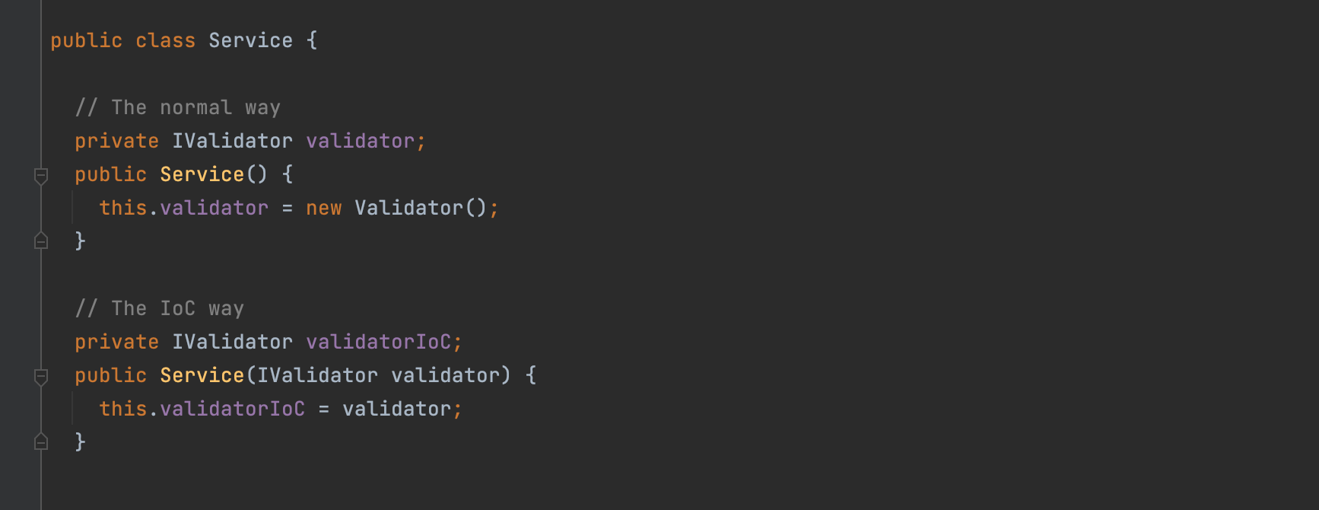
What is Spring?
IoC with Java example

Slide 6
What problem does Spring solve and how?

Slide 7

What is Spring?
Advantages of using :
Increase Testability.
The code is easy to maintain.
Easy to scale the application.
Reduce code complexity.

Slide 8
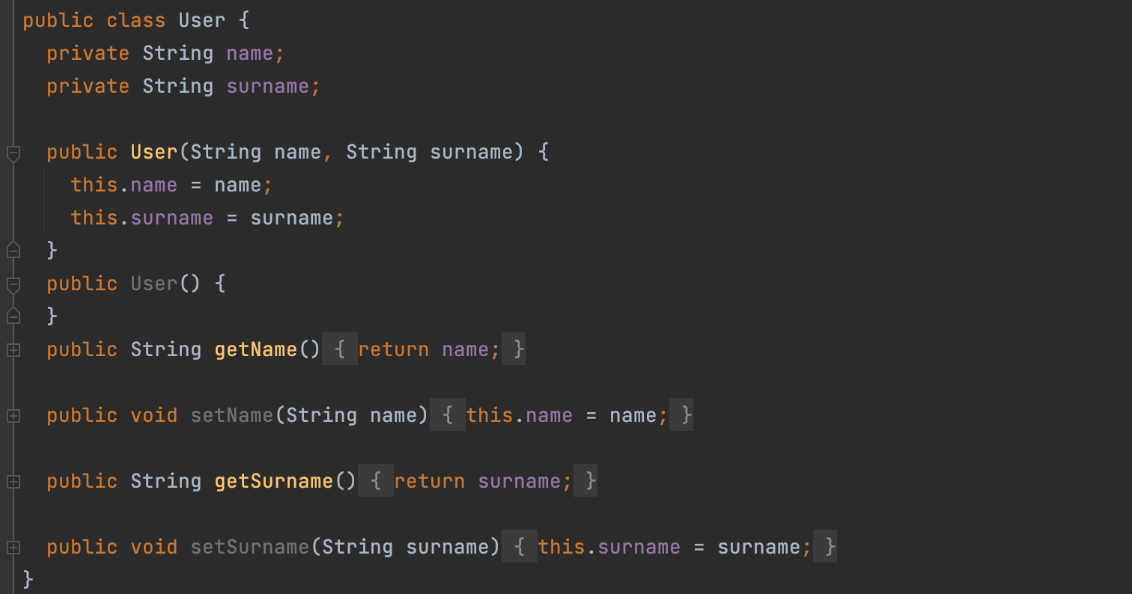
First, let’s define a model.

Slide 9
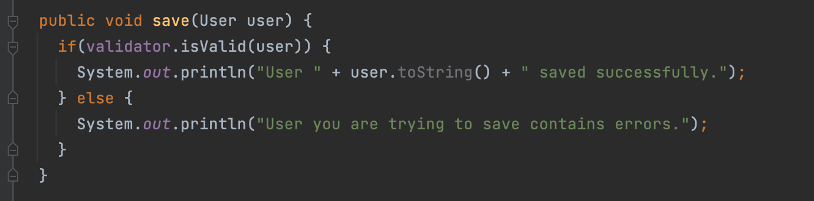
What is a dependency?

Slide 10
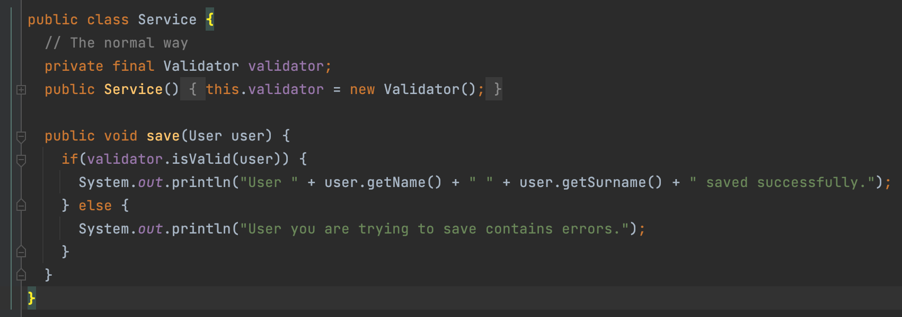
How to instantiate dependencies with new?

Slide 11
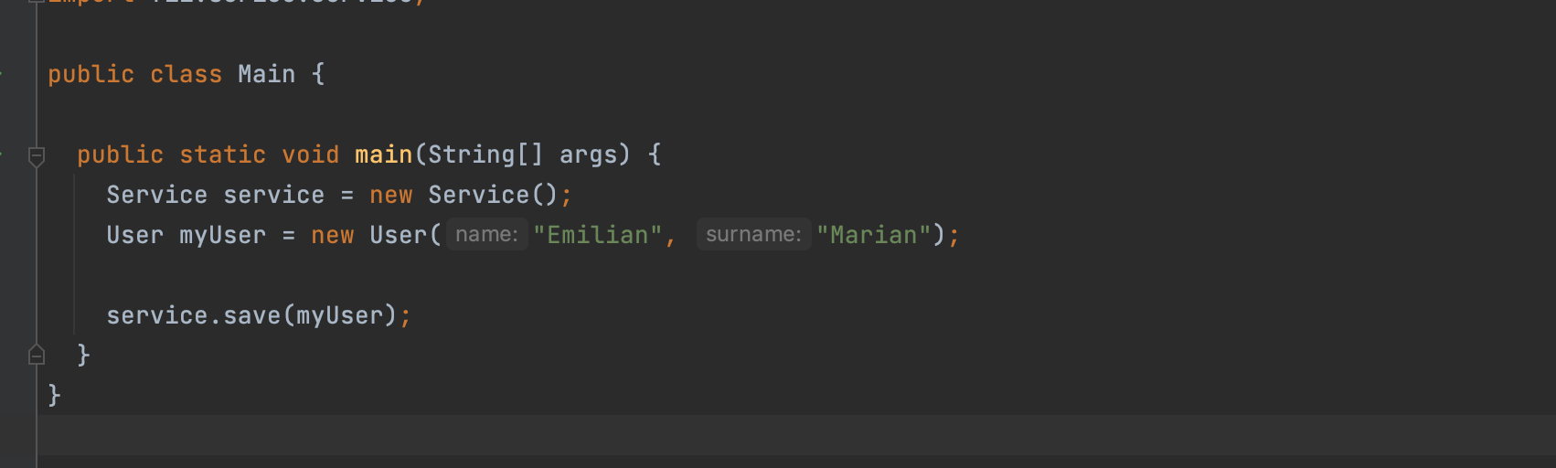
How does everything work together?

Slide 12
How does Spring resolve this dependency problem?
It creates an ApplicationContext that:
Manage the Beans of an application
ApplicationContext is the implementation of IoC
IoC is achieved with Dependency Injection
What is a Bean?
A bean is an object that is instantiated, assembled and otherwise managed by a Spring IoC

Slide 13
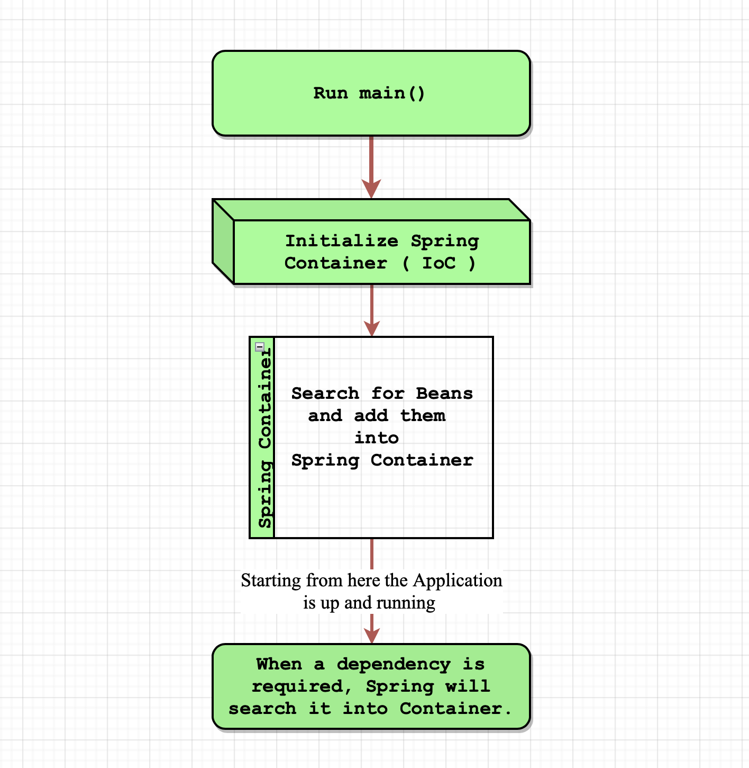
How Spring works?

Slide 14
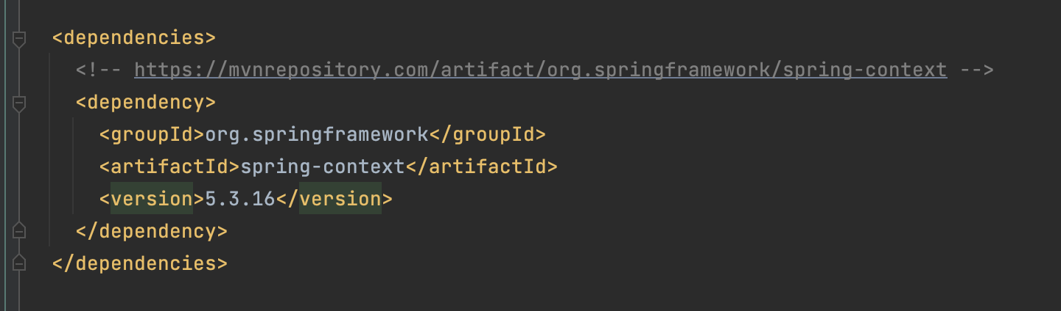
Add Spring to your project.

Slide 15
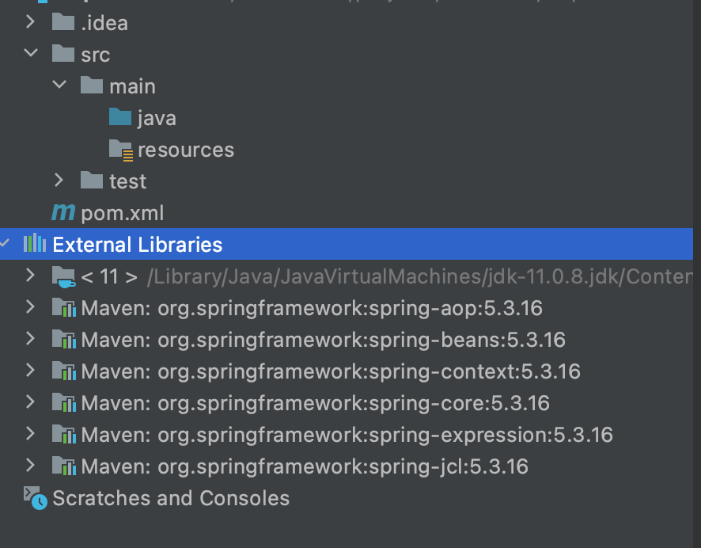
Add Spring to your project.

Slide 16
Use Spring for the code above

Slide 17

How to configure a Spring Application?
XML Configuration Annotations configuration
The XML configuration is at one place, instead of being scattered all over the source code in case of annotations. Some people may argue that IDEs like STS allow you to look at all annotations based configuration in one place, but I never like having dependencies on IDEs.
Its takes a little more efforts to write XML config, but it saves a lot of time later when you search for dependencies and try to understand the project.
XML keeps configuration well organized and simple. Hence is easier to understand, it helps new relatively inexperienced team members get up to speed quickly.
Allows you to change the config without a need to recompile and redeploy code. So it is better, when it comes to production support.

Slide 18
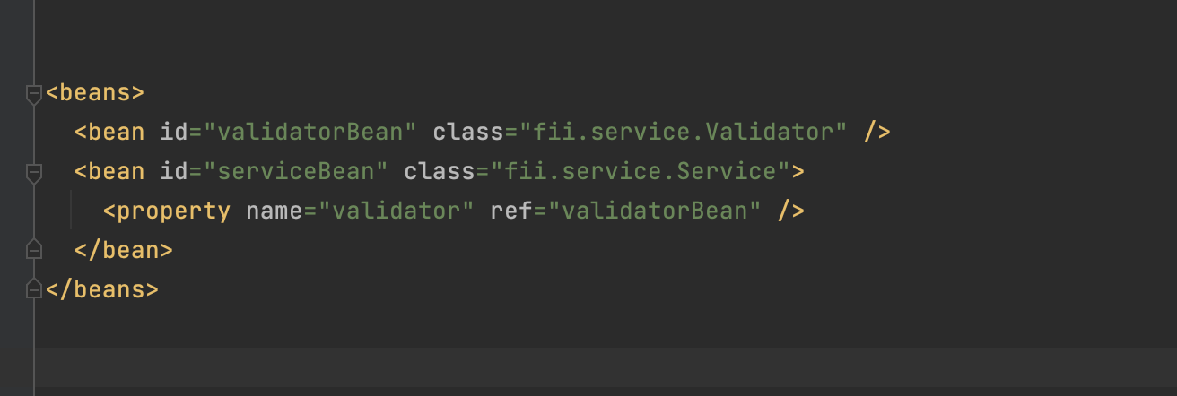
How an xml configuration file looks like?

Slide 19
Configure application with Spring
@Configuration
Indicates that a class declares one or more @Bean methods and may be processed by the Spring container to generate bean definitions and service requests for those beans at runtime
@Bean
Indicates that a method produces a bean to be managed by the Spring container.
A Bean is simply one of many objects in your application.
@Autowire
Marks a constructor, field, setter method, or config method as to be autowired by Spring's dependency injection facilities.

Slide 20
Configure application with Spring
@ComponentScan
With this annotation we can tell Spring where to search for classes annotated with @Bean, @Service, @Component or @Repository:
@Component - is a generic stereotype for any Spring-managed component.
@Service - annotates classes at the service layer.
@Repository - annotates classes at the persistence layer, which will act as a database repository.

Slide 21
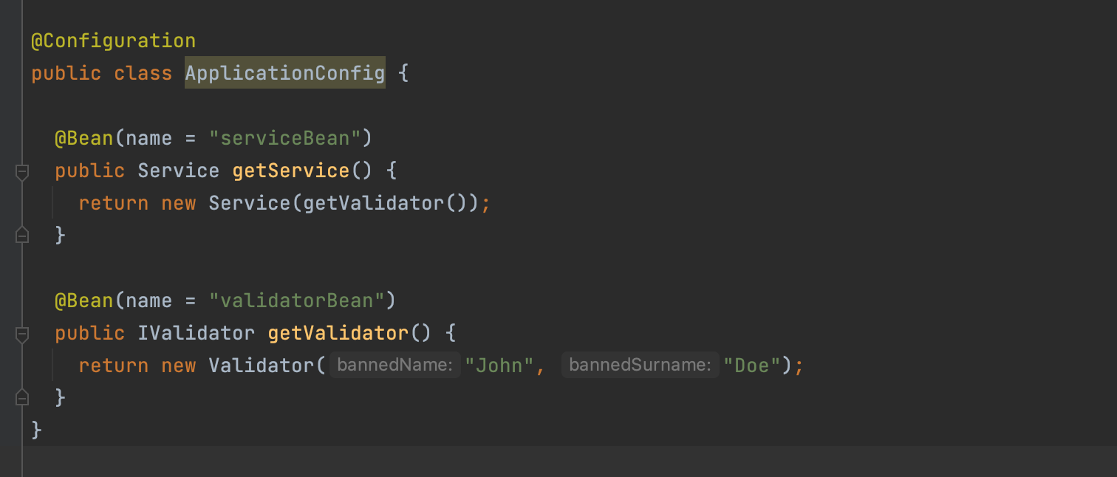
Configure application with Spring

Slide 22
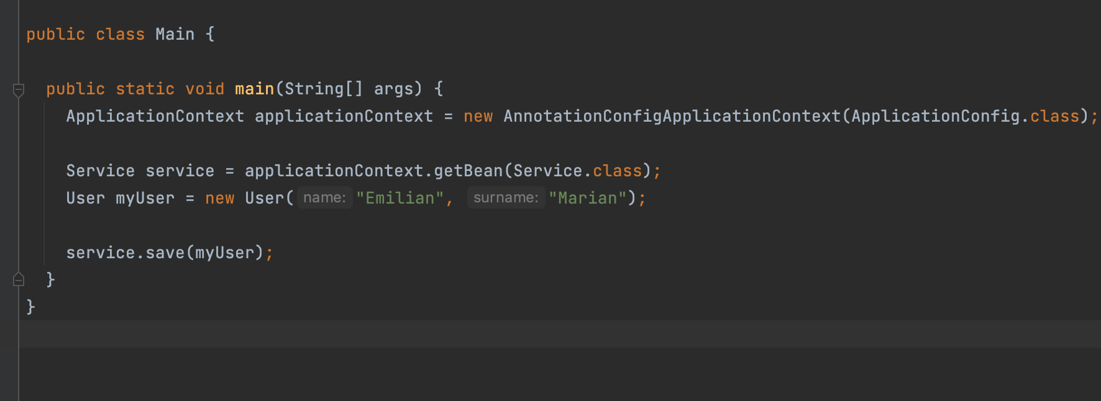
Configure application with Spring

Slide 23
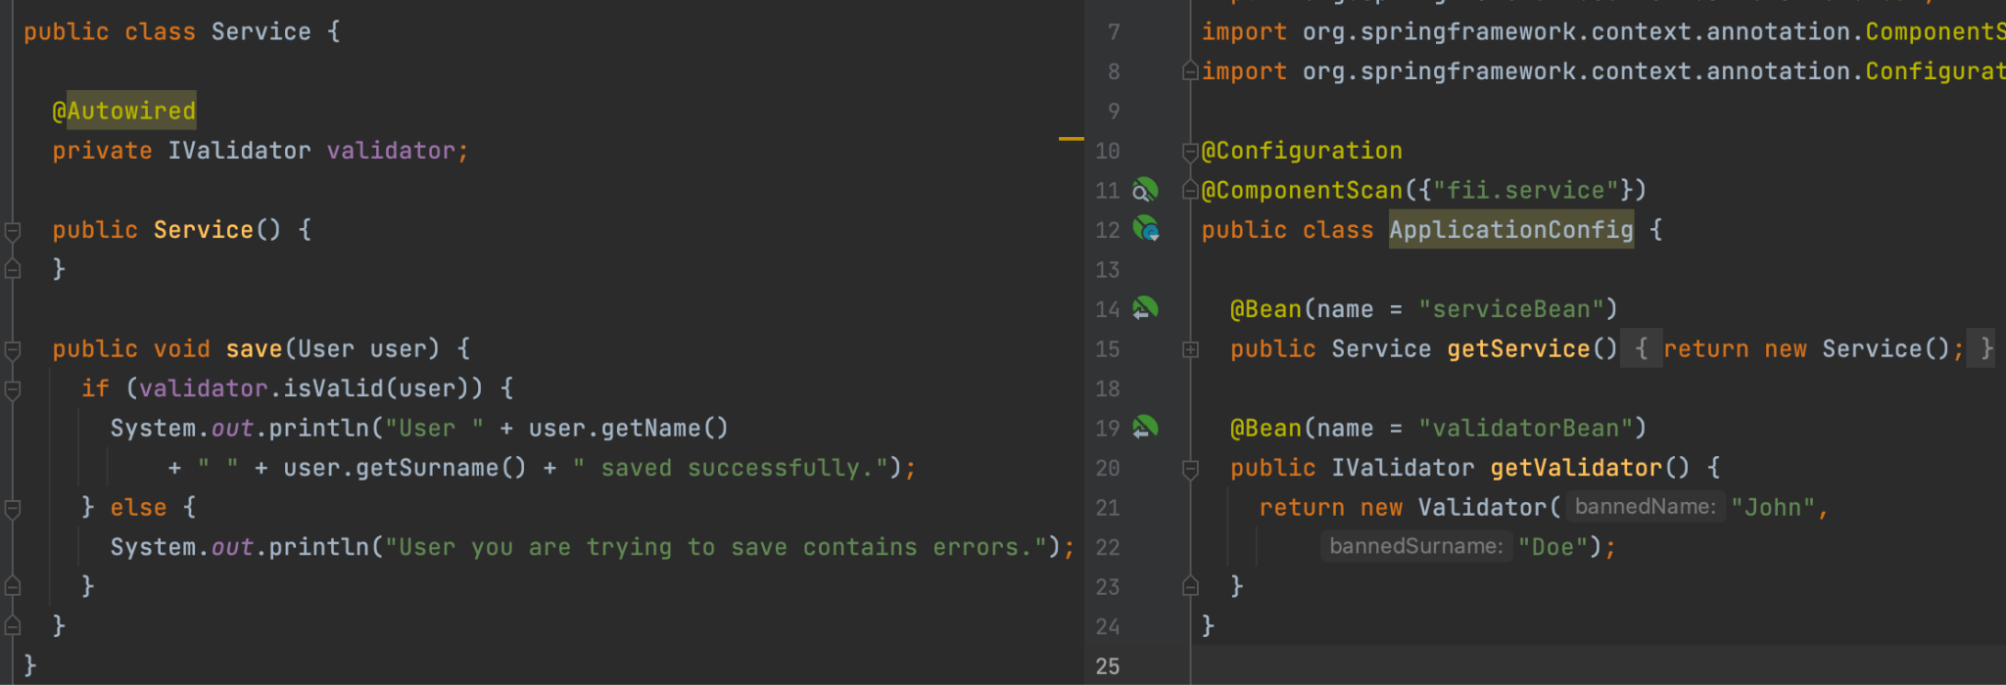
Configure application with Spring - Autowire

Slide 24
Let’s make an example together 🥳

Slide 25
Bean scopes

Slide 26
What is a scope?
When you create a bean definition what you are actually creating is a recipe for creating actual instances of the class defined by that bean definition.
Bean Scopes control the instance creation of the bean and how it is managed by the spring container.

Slide 27
Bean scopes
The latest version of the Spring framework defines 6 types of scopes:
singleton
prototype
request
session
application
websocket
Request, session, application and websocket scopes are only available in a web-aware application.

Slide 28
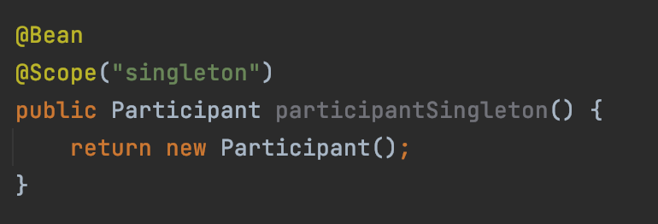
Singleton scope
When we define a bean with the singleton scope, the container creates a single instance of that bean
All requests for that bean name will return the same object, which is cached.
@Scope(value = ConfigurableBeanFactory.SCOPE_SINGLETON)

Slide 29
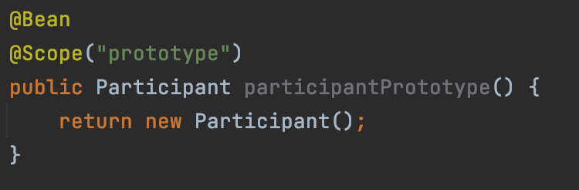
Prototype scope
A bean with the prototype scope will return a different instance every time it is requested from the container.
@Scope(value = ConfigurableBeanFactory.SCOPE_PROTOTYPE)

Slide 30
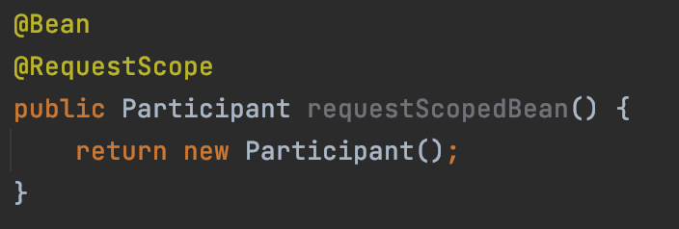
Request scope
The request scope creates a bean instance for a single HTTP request
@Scope(value = WebApplicationContext.SCOPE_REQUEST, proxyMode = ScopedProxyMode.TARGET_CLASS)
The proxyMode attribute is necessary because at the moment of the instantiation of the web application context, there is no active request. Spring creates a proxy to be injected as a dependency, and instantiates the target bean when it is needed in a request.

Slide 31
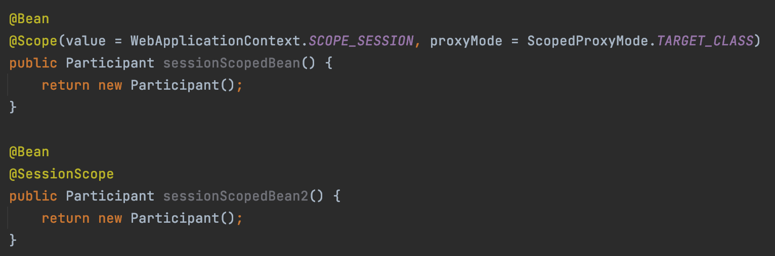
Session scope
The session scope creates a bean instance for an HTTP Session.
@Scope(value = WebApplicationContext.SCOPE_SESSION, proxyMode = ScopedProxyMode.TARGET_CLASS)

Slide 32
Application scope
The application scope creates the bean instance for the lifecycle of a ServletContext.
This is similar to the singleton scope, but there is a very important difference with regards to the scope of the bean.
When beans are application scoped, the same instance of the bean is shared across multiple servlet-based applications running in the same ServletContext, while singleton scoped beans are scoped to a single application context only.

Slide 33
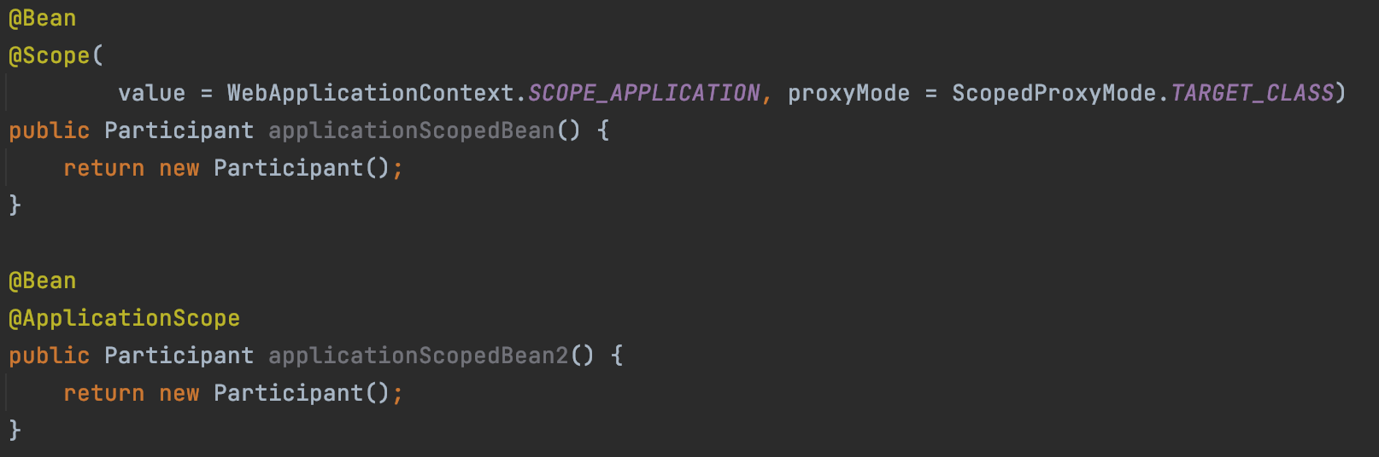
Application scope
@Scope(value = WebApplicationContext.SCOPE_APPLICATION, proxyMode = ScopedProxyMode.TARGET_CLASS)

Slide 34
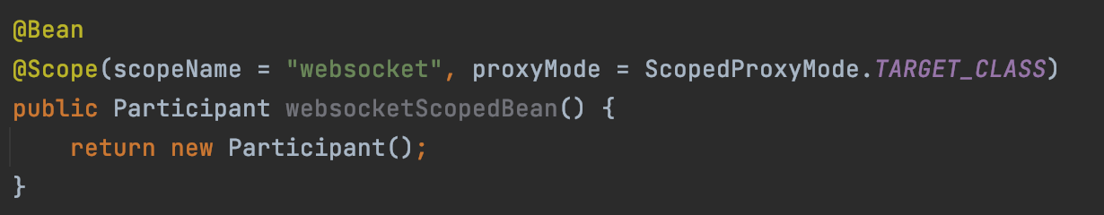
Websocket scope
When first accessed, WebSocket scoped beans are stored in the WebSocket session attributes. The same instance of the bean is then returned whenever that bean is accessed during the entire WebSocket session.
We can also say that it exhibits singleton behavior, but limited to a WebSocket session only.

Slide 35
Spring configurations

Slide 36
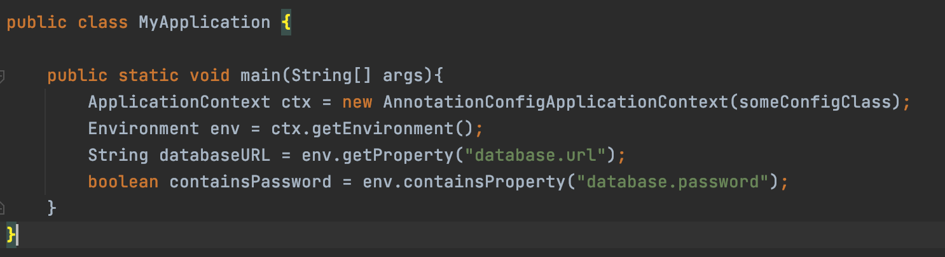
Environment properties

Slide 37
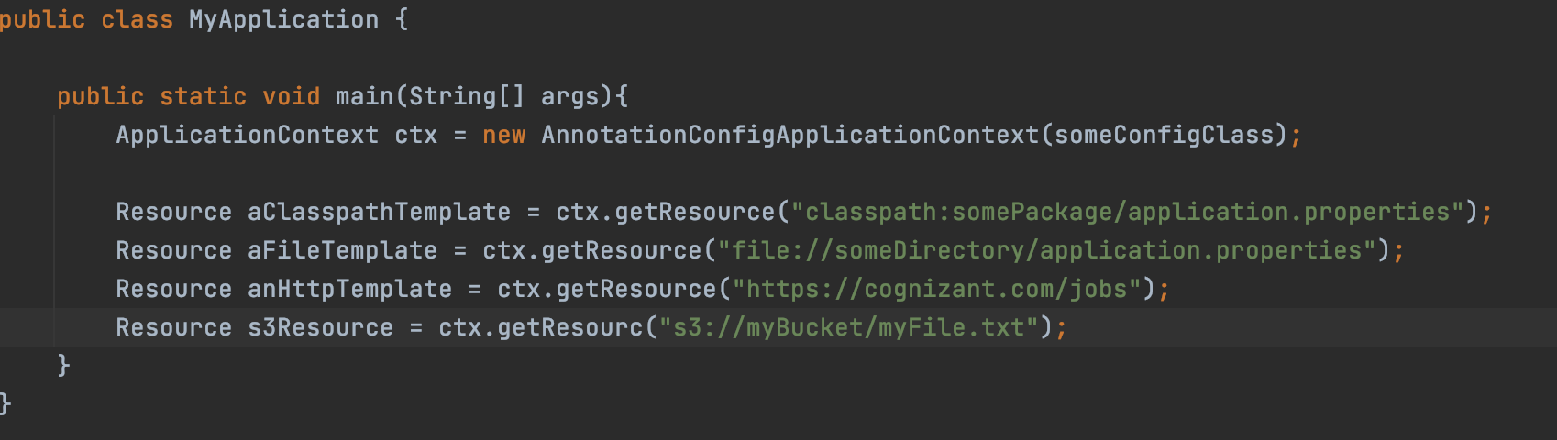
Resources

Slide 38
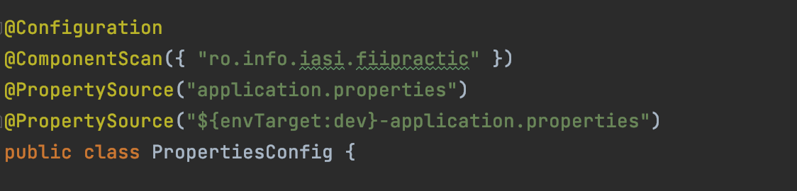
Property sources
Spring 3.1 introduced the @PropertySource annotation as a convenient mechanism for adding property sources to the environment.
Another very useful way to register a new properties file is using a placeholder, which allows us to dynamically select the right file at runtime
The @PropertySource annotation is repeatable according to Java 8 conventions. Or you can use the @PropertySources annotation and specify an array of @PropertySource.

Slide 39
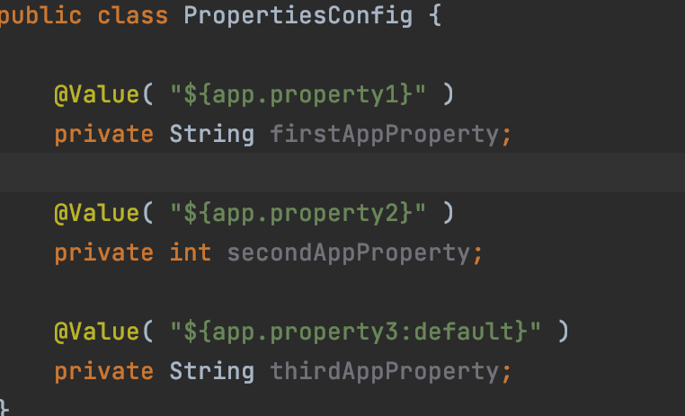
Using/Injecting Properties
Injecting a property with the @Value annotation is straightforward
You can also specify a default value for the property

Slide 40
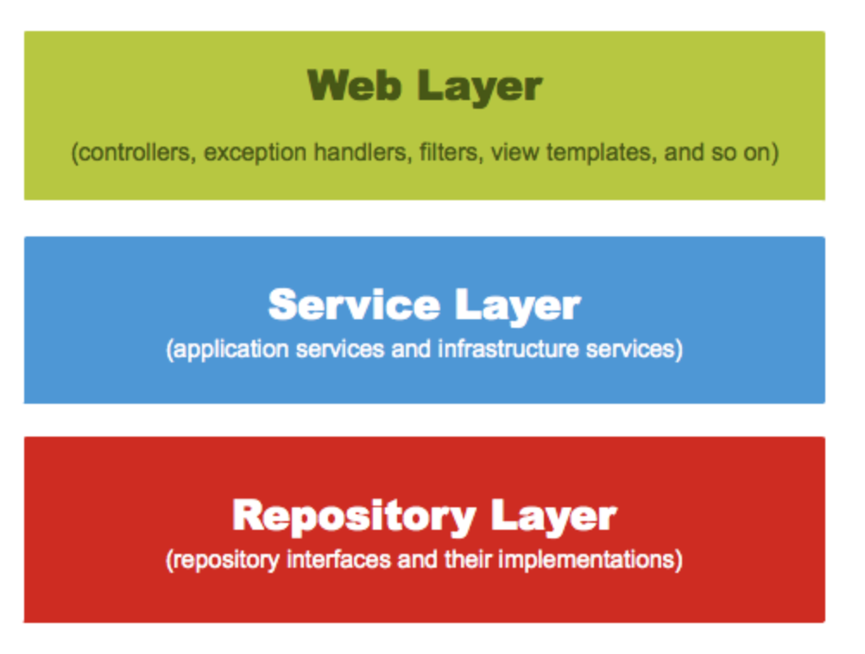
Separation of concerns

Slide 41
Spring Modules
Spring Data - Spring-based programming model for data access while still retaining the special traits of the underlying data store
Spring MVC - the original web framework built on the Servlet API and has been included in the Spring Framework from the very beginning
Spring Security - a powerful and highly customizable authentication and access-control framework
Spring Cloud - provides tools for developers to quickly build some of the common patterns in distributed systems

Slide 42
Lab exercises

Slide 43
Laborator Exercises
Create a Car class with an Engine object that has a method which prints “Vrum, Vrum”
Use Spring to inject the Engine object inside the car.
Define the Engine bean as a Prototype.
Create Github repository and push the code.

Slide 44
Thank you!

